Slide 1
St. Johns County Digital Conversion Initiative
Creative learning environment of the future… Now!

Slide 2
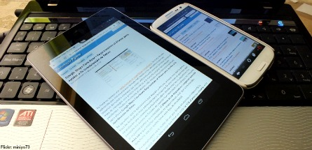
“When I go to school,
I have to ‘power down.’”
-High School student

Slide 3
SJCSD Vision:
Provide students with opportunities to be engaged in a technology rich environment that enhances teaching, fosters learning and develops essential life skills for all students.

Slide 4
Guiding Principles:
The process to achieve our vision must be monitored strategically to ensure student learning.
The identification of high-quality curriculum content is essential to the success of meeting student needs.
The technology used must be student-centered.
Professional development for teachers must be provided.
The proper infrastructure support is critical to the success of implementing the technology vision.
The most appropriate technology devices will be identified to meet assessment and curriculum needs for all students.
The technology support must be proportional to the number of devices per school site and the service level needed.
The model must be able to be implemented throughout the school district.

Slide 5
Why technology? … Why Now?
Increased Engagement
Cooperative Learning
Differentiated Learning
Empowers Learning
Notes:
Attuned to student interest
Authentic / Real world learning
Project based learning
Career readiness – aligns classroom projects to the workplace environment
Student Ownership in Learning
Teaches students how to learn and allows for self guided learning and exploration
Creativity
Access to the world
Efficient

Slide 6
Why technology? … Why Now?
Increased ability to create customized pathways to learning
Prepares students for College and Career readiness
Florida State Statute 1006.40
Computer Based Testing
Realignment of textbook allocation budget
Online HS course required before graduation
Notes:
(3)(a.) By the 2015-2016 fiscal year, each district school board shall use at least 50 percent of the annual textbook allocation for the purchase of digital or electronic instructional materials that align with state standards.
From <http://www.leg.state.fl.us/statutes/index.cfm?App_mode=Display_Statute&Search_String=&URL=1000-1099/1006/Sections/1006.40.html>
Additionally, the state requires students to take one online course in order to graduate high school. Florida students are also more likely to take a standardized test on a computer than in other states.
From <http://stateimpact.npr.org/florida/tag/technology/>

Slide 7
Technology Plan
K-2 Touch Tablet Devices
3-12 Laptop Devices

Slide 8
What can parents do to help at home?
Parent Can:
Set guidelines for technology use.
Teach children about identifying reliable resources online. (see “Criteria to evaluate web resources”) we need to add to our site
Talk to children about information literacy.
Attend Parent Workshops (see schedule) Attendance mandatory for home use!
http://blogs.stjohns.k12.fl.us/instructionaltech/?page_id=1000
Notes:
Schedule and Set time limits
Encourage them to eliminate distractions
Occasionally sit with your child
Monitor access
Ask what they are learning/ discuss learning
(optional) At home, parents can set rules about technology use and teach their children about identifying good resources online. If the children have an online assignment, parents can set up the steps to look up the information. The children drive the learning, and the parents can step in to help. It’s also important for parents to talk to children about information literacy: How do you know which link to click on in a Google search? How do you know if a link leads to a reliable source? Does the Wikipedia article have a source you can trust?

Slide 9
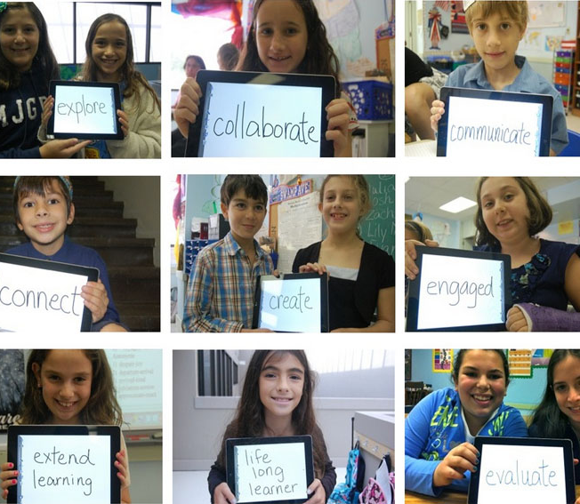
Benefits?
Increased student engagement
Improved attendance
Customized learning
Improved student achievement
Preparation for future techno-learning environments
Preparation for post secondary experiences

Slide 10
If we teach today
like we taught yesterday
we rob our children
of tomorrow.
- John Dewey

Slide 11
Images:
http://resourcecomputer.com/wp-content/uploads/2012/11/ipadcluster-300x233.jpg
http://tech-jewel.wikispaces.com/file/view/educational_technology_by_laila.jpg
http://scm-l3.technorati.com/11/10/18/54143/collaboration.jpeg?t=20111018151054
http://drcash.sbcisd.net/wp-content/uploads/2011/11/homeschool.gif
http://storage.theinformationdaily.com/images/medium/518.jpg
http://pelhampubliclibrary.files.wordpress.com/2013/07/ipad-transforming.jpg
Information:
http://www.leg.state.fl.us/statutes/index.cfm?App_mode=Display_Statute&Search_String=&URL=1000-1099/1006/Sections/1006.40.html>
http://stateimpact.npr.org/florida/tag/technology/
http://www.digitaljlearning.org/blog/2014/01/30/technology-and-blended-learning-schools-what-parents-need-know#.U1XAM2qYbX4

